Slide 1



The Age of Abalone

Slide 2

Abalone Problem
The goal is to detect the age of abalone. If a reasonably accurate model could be found to predict the age of abalone, then the farmers would minimize the cost and customers would get the expected goods.
Clear Question
What is The Most Accurate Model to Predict The Age of Abalone ?
Description

Slide 3
What is The Most Accurate Model to Predict The Age of Abalone ?

Slide 4

Data Preparation

Slide 5
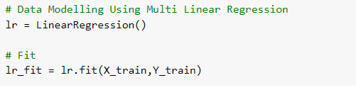


Linear Regression Model

Slide 6
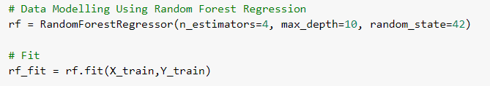


Random Forest Regression Model

Slide 7
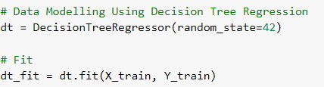

Decision Tree Regression Model

Slide 8
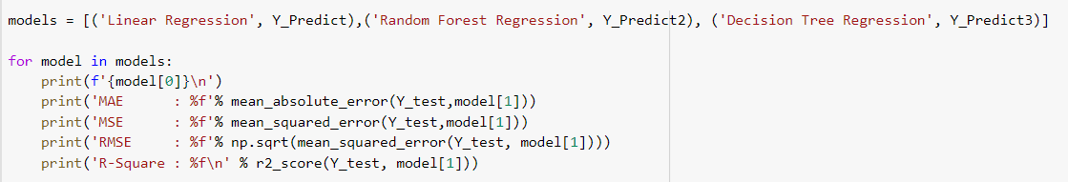
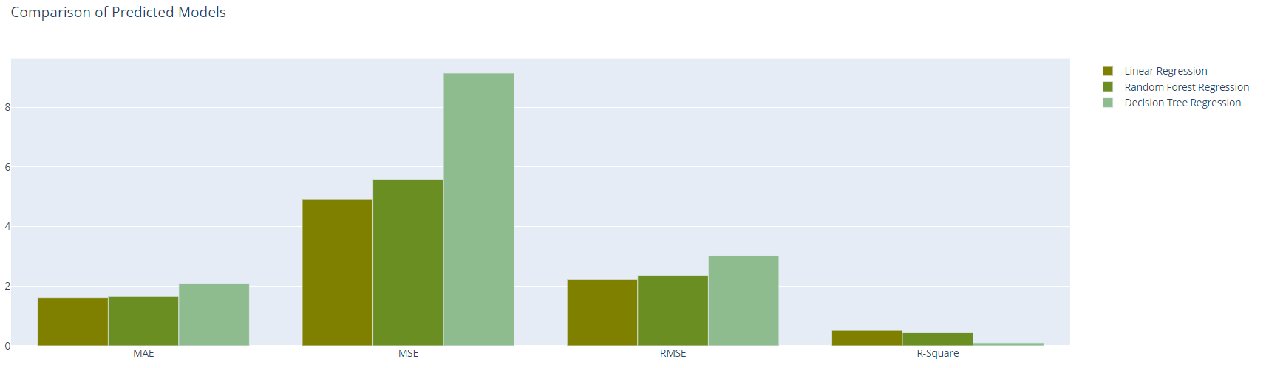
Model Comparison
Linear Regression
MAE : 1.618718
MSE : 4.926431
RMSE : 2.219557
R-Square : 0.514855
Random Forest
Regression
MAE : 1.651170
MSE : 5.585589
RMSE : 2.363385
R-Square : 0.449943
Decision Tree
Regression
MAE : 2.086124
MSE : 9.145136
RMSE : 3.024093
R-Square : 0.099406

Slide 9
Conclusion Model
After we compare the value of MAE, MSE, RMSE and R-Square from all of the methods, we can conclude that the best model for Predicting The Age of Abalone is using Linear Regression.
As we can see that linear regression has the smallest value of MAE, MSE and RMSE and the biggest value of R-Square of all the methods that we use.
The Regression Model
Age = 11.458 + 0.065 Sex - 0.072 Length + 1.25 Diameter + 0.467 Height + 4.994 Whole Weight - 4.872 Shucked Weight - 1.077 Viscera Weight + 1.089 Shell Weight

Slide 10

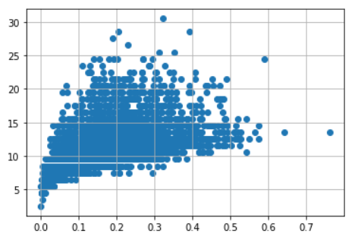
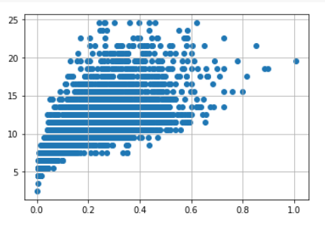

Outliers handlings

Slide 11

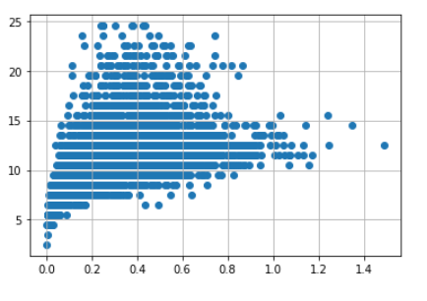
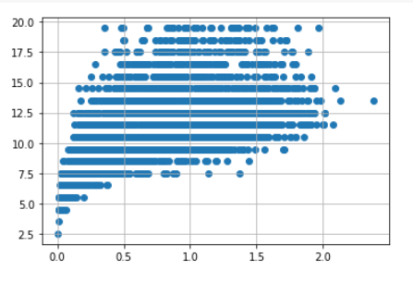


Slide 12
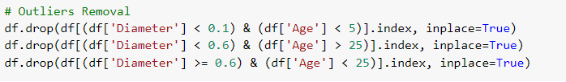
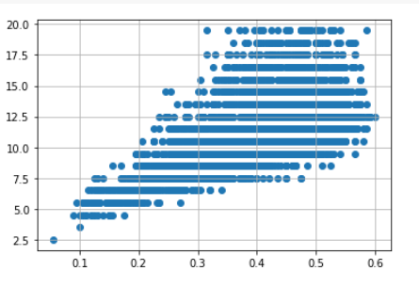
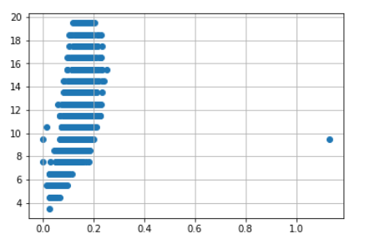


Slide 13
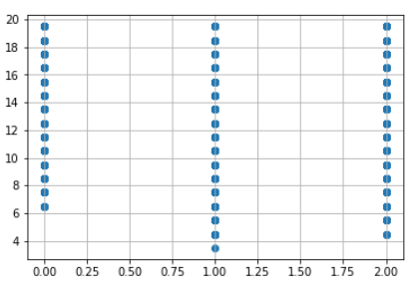


Slide 14
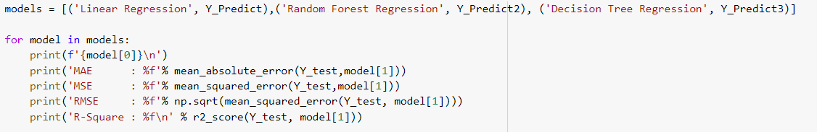
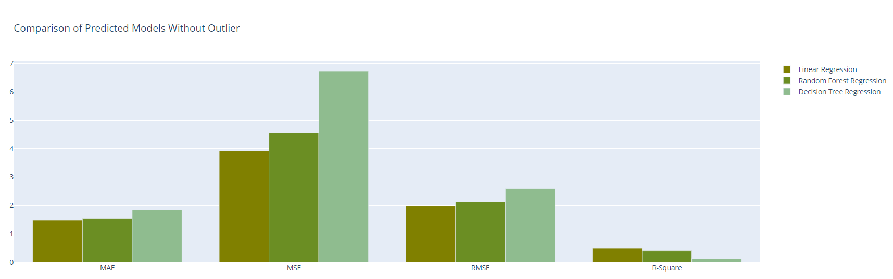
Model Comparison Without Outliers
Linear Regression
MAE : 1.479775
MSE : 3.920200
RMSE : 1.979949
R-Square : 0.491635
Random Forest Regression
MAE : 1.539986
MSE : 4.559642
RMSE : 2.135332
R-Square : 0.408713
Decision Tree
Regression
MAE : 1.860485
MSE : 6.737678
RMSE : 2.595704
R-Square : 0.126268

Slide 15
Conclusion Model Without Outlier
After we compare the value of MAE, MSE, RMSE and R-Square from all of the methods, we can conclude that the best model for Predicting The Age of Abalone Without Outlier is using Linear Regression.
As we can see that linear regression has the smallest value of MAE, MSE and RMSE and the biggest value of R-Square of all the methods that we use.
The Regression Model
Age = 11.458 + 0.065 Sex - 0.072 Length + 1.25 Diameter + 0.467 Height + 4.994 Whole Weight - 4.872 Shucked Weight - 1.077 Viscera Weight + 1.089 Shell Weight

Slide 16
Reference
https://www.kaggle.com/rodolfomendes/abalone-dataset
https://mpra.ub.uni-muenchen.de/91210/1/MPRA_paper_91210.pdf
https://becominghuman.ai/machine-learning-series-day-6-decision-tree-regressor-82a2e2f873a
https://www.quora.com/What-is-the-difference-between-scikit-learns-random-forest-classifier-and-random-forest-regressor

Slide 17

THANKS

